Slide 1

Reflection in Java
Mrinal kanti Saha

Slide 2
Contents
Demo of Reflection
Definition
Classes involved in reflection
FAQs
Uses
Disadvantages
References

Slide 3
Let’s see what we can do with Reflection…
Before we head into the theory part…

Slide 4
We have a class “Testclass”
Fields :-
private int private_field
public String public_field
public static int static_field
private final int final_field
Constructor :-
public Testclass()
Methods :-
private void func1()
public void func2()

Slide 5
How are we to know the contents of a class from only “Testclass.class” ?
Provided we do not have a decompiler.
Let’s see whether it can be done...

Slide 6
Now, can we peep into the values of an Object’s fields at run-time ???
public members are anyways visible.
But, private & protected ?
We can have a generic toString()

Slide 7
Change the values of private fields ? Invoke the private methods ?
C++ had friend function to do so.
But, in JAVA , it is totally a run-time thing.

Slide 8
Let’s go for the definition now
Reflection - an API, used to examine or modify the behavior of methods, classes, interfaces at runtime.
class Class is the major class used with reflection.
Rest all the necessary classes are under “ java.lang.reflect “.
Introduced in JDK 1.1

Slide 9
Classes involved in Reflection

Slide 10
The Class class
Under java.lang package
Universal type for the metadata that describes objects within the Java system.
Methods :-
forName()
getClass()
newInstance()
getSuperClass()
getInterfaces()

Slide 11
Classes in java.lang.reflect
Field
getDeclaredFields()
getModifiers()
get(obj)
set(obj, value)
Method
getDeclaredMethods()
invoke(obj, parameters[])
Constructor
getConstructors()
AccessibleObject
setAccessible(boolean)

Slide 12
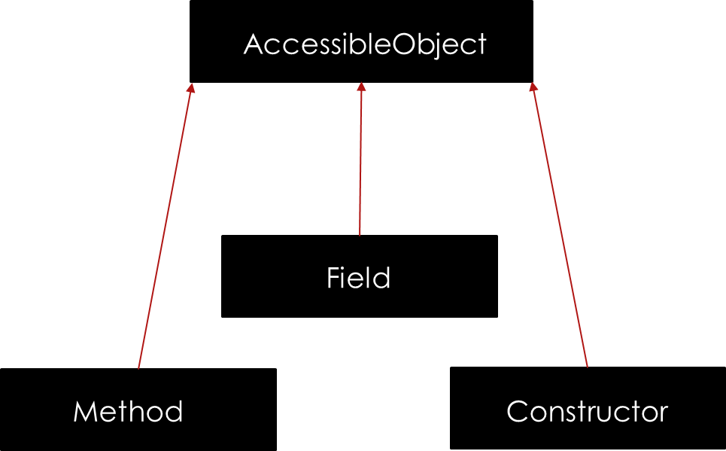
Classes in java.lang.reflect
Field
getDeclaredFields()
getModifiers()
get(obj)
set(obj, value)
Method
getDeclaredMethods()
invoke(obj, parameters[])
Constructor
getConstructors()
AccessibleObject
setAccessible(boolean)

Slide 13
FAQs

Slide 14
FAQs
Is there no way to curb Reflection ?

Slide 15
FAQs
Is there no way to curb Reflection ?
SecurityManager manages access to the private members of an object.
With the SecurityManager turned on, using Reflection on private or protected, will lead to SecurityException.

Slide 16
FAQs
Does reflection break all the myths about data security via abstraction and access modifiers ?

Slide 17
FAQs
Does reflection break all the myths about data security via abstraction and access modifiers ?
Yes and No

Slide 18
Why is it not used commonly ?
Performance Overhead
Security Restrictions
Exposure of Internals

Slide 19
Where is it used ?
Debugging tool (recall GDB)
JDBC (Java DataBase Connectivity)
JavaBeans
Visual Development Environment
Java based Web Servers (e.g. Tomcat)

Slide 20
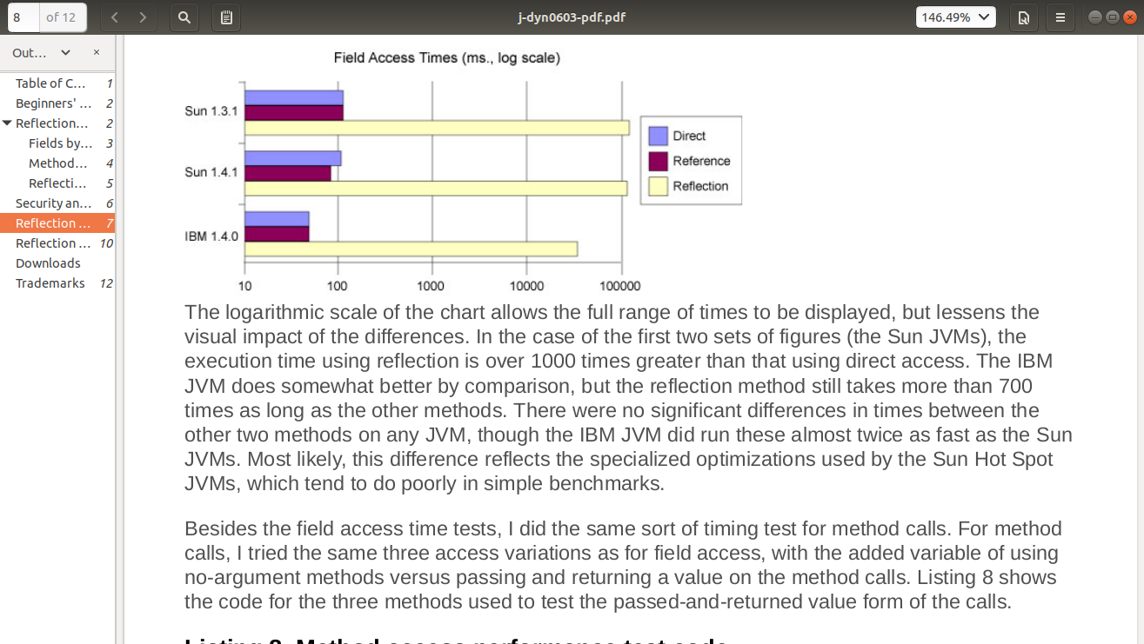
Performance Overhead (Field access)

Slide 21
References
GeeksforGeeks
Core Java, Volume I
JournalDev
JenkovPoint
IBMdeveloperWorks

Slide 22
Thank You…

